Slide 1




Performance Measurement Tool User Guide
VOCA Victim Assistance Grant Program Subgrantees
Updated November 2017

Slide 2

Contents
Overview and Purpose of User Guide
Accessing and Logging in to the PMT
Administration Section Features
Entering Subgrant Award Reports
Preparing the Subgrantee Data Report
Troubleshooting Tips and Additional Resources

Slide 3
Overview and Purpose
of User Guide

Slide 4
Overview & Purpose
The Performance Measurement Tool (PMT) collects performance measurement data on a quarterly basis. Your grantee will determine your quarterly due dates for entering data in the PMT.
The purpose of this user guide is to instruct the Office for Victims of Crime (OVC) PMT users on the following—
  How to access and navigate the PMT
  Actions to ensure your report is correctly submitted
  Troubleshooting steps for errors that users may encounter.

Slide 5
Roles of Subgrantees
As a subgrantee, your role in performance measurement reporting includes the following—
Identifying individuals who need system access and understanding what data the grantee will need you to enter into the system
Contributing information to the Subgrant Award Report (SAR), if directed
by the grantee
Entering performance measures quarterly, if directed by the grantee
Clarifying and updating data in response to any inquiries from the grantee.

Slide 6
PMT Definitions
Performance Management: The regular collection of data in a systematic manner to assess program outputs/outcomes, showcase program results, and improve program performance.
Reporting Systems:
Performance Measurement Tool (PMT): The online system maintained by the Office for Victims of Crime (OVC) for collecting performance measure data from grantees and subgrantees.
Grants Management System (GMS): The online data collection system maintained by the Office of Justice Programs (OJP) for all grants administered through OJP. GMS is the priority system of record for information about grants.

Slide 7
PMT Definitions (cont.)
Parties Involved:
Grantee: The primary grant recipient of funds directly from the Office for Victims
of Crime (OVC).
Subgrantee (or Subrecipient): An entity that receives a portion of grant funding through a formal agreement with the grantee. Grantees are required to monitor subgrantees to ensure subgrant funds are appropriately spent.
State Administering Agency (SAA): The grantee; the state office responsible for receiving funds and reporting data.

Slide 8
PMT Definitions (cont.)
Reports:
Subgrant Award Report (SAR): This report collects information about the subgrantee organization, the length of the subawards and activities to be implemented by the subgrantee, and the allocation of grant funds.
Subgrantee Data Report: This report collects information quarterly on victims served with Victims of Crime Act (VOCA) plus match funding, including victim demographics, types of victimization, and services provided.
Annual Grantee Report: This report collects the information on victims served with Victims of Crime Act (VOCA) plus match funding over a federal fiscal year (October– September). The report is a PDF document that the PMT automatically generates after all data entry is complete.

Slide 9
Accessing and
Logging in to the PMT

Slide 10

Accessing the PMT
Grantees will determine if subgrantees
will enter data in to the PMT.
Grantees will establish their processes and timelines for subgrantee data entry and review.
Grantees will set up user accounts for subgrantee users by entering their contact information into the PMT. The system will then send the subgrantee user an email to set up a password and complete the account set up process.
Each individual user must have his or her own unique login to access the system for security purposes.
Important Note: The OVC PMT Helpdesk cannot add subgrantee users; only grantees can add subgrantees as users.

Slide 11

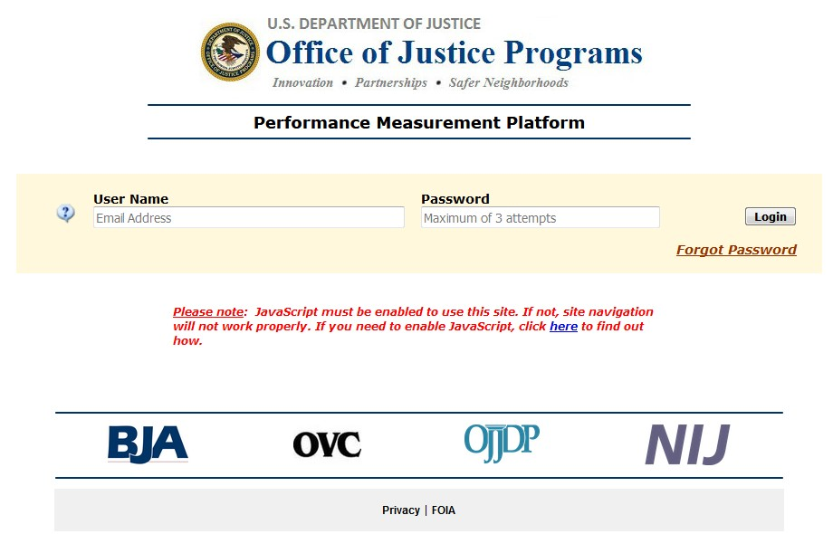
Logging in to the PMT
Visit the PMT website at this address, https://ojpsso.ojp.gov/, and enter your user name and password.
The user name is the user’s
email address.
If the grantee provides you with access to the PMT, you will receive an email from OVC PMT with instructions on creating a new user account.

Slide 12

Logging in to the PMT (cont.)
If you forget your password:
Enter your user name (email address) and leave the password field blank.
Select Forgot Password.
Enter and submit the answer to your
challenge question.
If this is correct, the PMT will send you an email with a link to create a new password.
Passwords must be at least 12 characters and contain both upper and lowercase letters, one number, and one
special character (e.g., !, @, $).

Slide 13

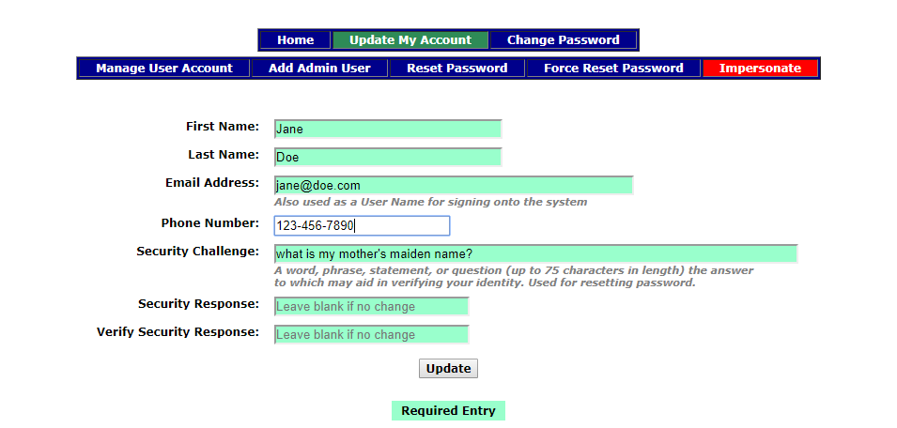

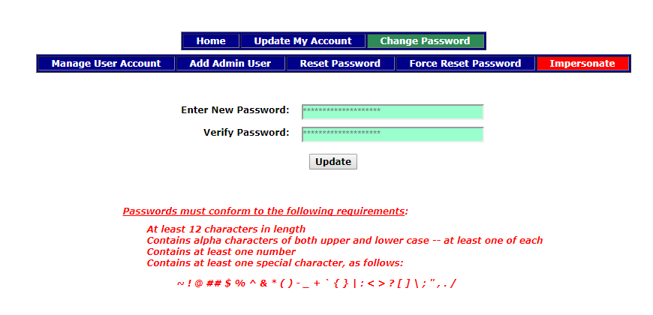
Updating Your User Account and
Changing Your Password
1
Account button to update your login information (see Image 1).
Select the Change Password
Image 2).
2
Please remember to adhere to the password guidelines that are shown on the screen.

Slide 14

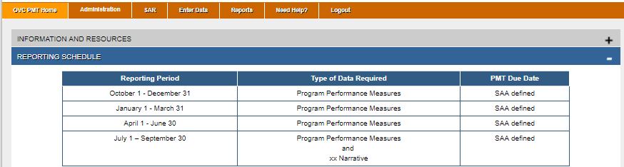
OVC PMT Home Page
On the OVC PMT Home Page, you can view information and resources, as well as the reporting schedule.

Slide 15


Main Navigation Menu
OVC PMT Home: General information about your award and reports
Administration: List of subawards and user information associated with your award
SAR: Data entry pages for all Subgrant Award Reports associated with your award
Enter Data: Data entry pages for the quarterly Subgrantee Data Report
Reports: Lists current and past reports and their status
Need Help: Resources for using the PMT and submitting feedback/questions
Logout: Logs you out of the PMT system

Slide 16
Administration Section
Features

Slide 17

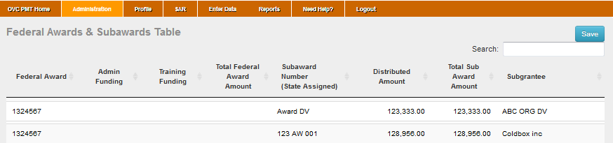
Administration:
Federal Award List
From the Federal Award List under the Administration tab, you can view a list of
your state’s federal awards and search for subawards.
For subawards to show up on the list, the Subgrant Award Report (SAR) must have the subward amount listed.

Slide 18

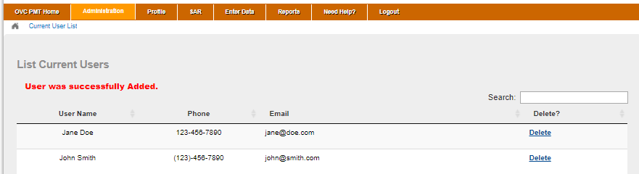
Administration:
User List
The List of Current Users displays all users for your organization. Organizations
should manage their users.
You may delete users who are no longer with your organization or engaged in PMT data entry.
You may add individuals who should have access for data entry and review purposes.

Slide 19
Entering Subgrant
Award Reports

Slide 20

Quick Tips for Navigating the PMT
Periodically click the Save and Continue button to ensure the data you entered are saved into the system. The system will time you out after 30 minutes of inactivity and data not saved will be lost.
Please note that simply entering data into a field does not constitute as activity; the system only recognizes saving or the advancement to another page as activities that will keep your session active.
Click the Exit Data Entry button to close and exit the page. Please note that any data not previously saved will be lost. The Exit Data Entry button does NOT automatically save your work.
Save and Continue
It is critical to periodically click the Save and Continue button to save your work.

Slide 21
Quick Tips for Navigating the PMT
The list below includes tips for using and navigating the PMT system. Please review this
list and use it as a reference throughout the data entry process.
Hovering over underlined text will prompt helpful language explaining the question to appear.
You must enter a numeric value in all fields marked “Number;” no other value will
be accepted.
Answer all applicable questions on the page, then press the Save and Continue button.
To go back and reselect any data, select the Save and Continue button to ensure the
data already entered into the system is saved.

Slide 22
Quick Tips for Navigating the PMT
The response option “NA” (not applicable) is only allowed if you need to indicate that the variable is not applicable to the state’s program or crime type.
The response option “NT” (not tracked) is only allowed if you need to indicate that the state’s laws or regulations allow the type of service but you are unable to collect this data during the reporting period due to the need to change the data collection system.
The response option “0” (zero) is only allowed if you need to indicate a true value of “0.” A true value of zero means that the state has the ability to collect and does provide for that expense type, however, there is no data to submit for the reporting period.
A Note on Data Validation: The PMT will notify you if your response to a specific measure is not accurate, based on your previous responses. The PMT will also inform you if your response to a particular measure should be less than, equal to, or more than your previous response. You many not be able to select Save and Continue or submit your report if the system displays a data validation error with your entry.

Slide 23
Entering Subgrant Award Report
Data
A Subgrant Award Report (SAR) is required for each subgrant that implements
programming with VOCA plus match funding.
  Please see the Subgrant Award Report FAQ document for details on when SARs are required.
However, only one Subgrantee Performance Data Report is required for each subgrantee organization.
SAR Part 1 (Questions 1–6):
  Subaward information
  Must be completed by the grantee
SAR Part 2 (Questions 7–11):
  Information about the subgrantee
  May be completed by the grantee or subgrantee

Slide 24
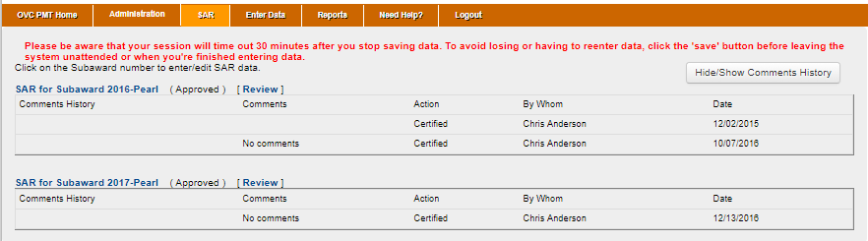
Subgrant Award Report (SAR)
Under the SAR tab, you will find a list of the SARs for each of your subawards.
Select the subaward for which you want to enter data.

Slide 25

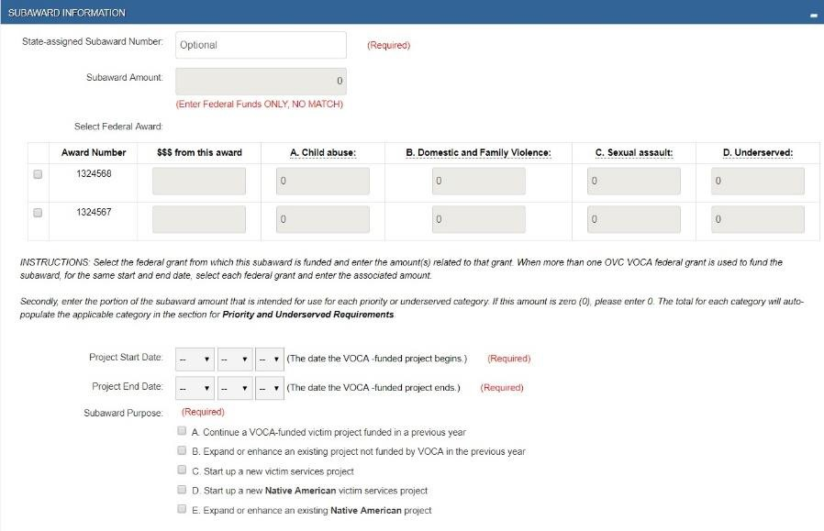
SAR – Part 1
Only your grantee can enter
data in SAR – Part 1.
You can select SAR – Part 1 to see the data already entered by the grantee.

Slide 26

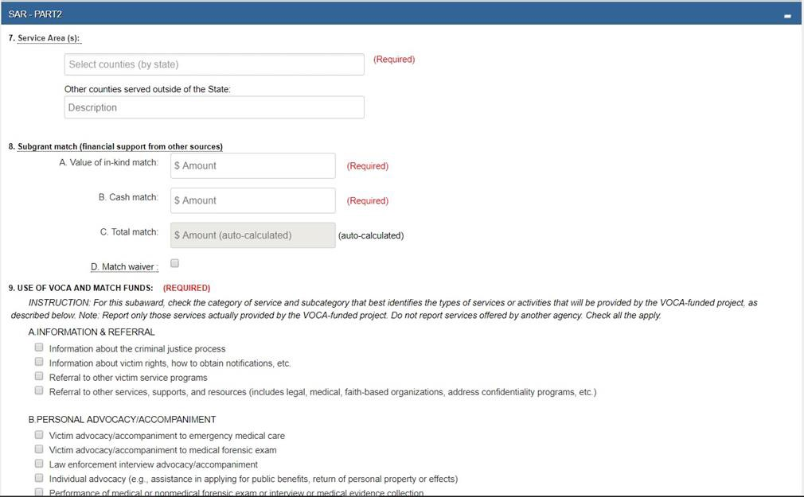
SAR–Part Two: Subgrantee Information
(Questions 7–11)
Grantees are able to allow subgrantees to enter data on Part 2 of the SAR, or they may complete this portion of the report themselves.

Slide 27

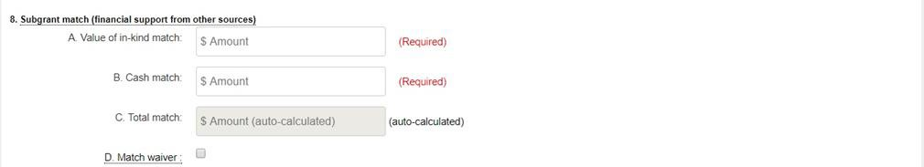
SAR–Part Two: Subgrantee Match
In Question 8, please enter the values of in-kind,
cash, and total match funding provided.
The match must be 20 percent of the total project budget. For example, see the pie chart to the right: if a subgrant award is $30,000, then the match requirement is $7,500.
Consult with your SAA regarding options for a
Sample Project Budget:
$37,500
Match:
$7,500 (20%)
Award:
$30,000 (80%)
match waiver.

Slide 28

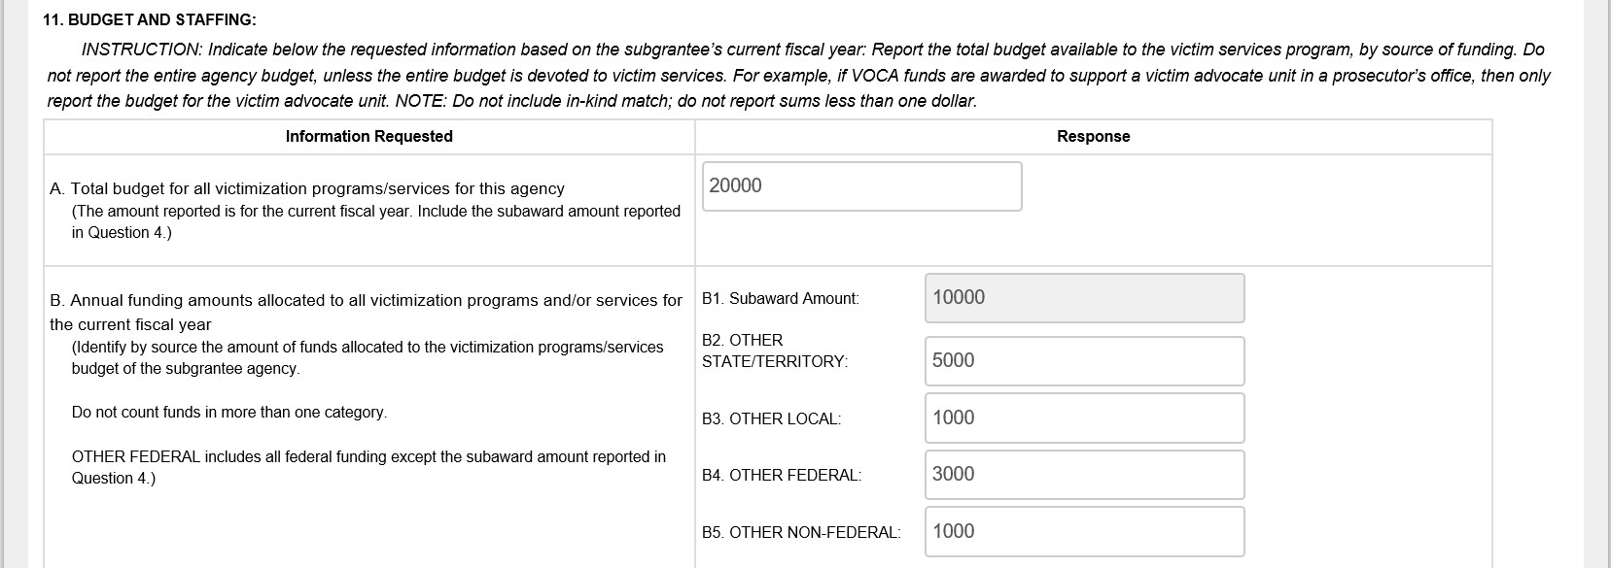
SAR–Part Two: Budget and Staffing
In Question 11.A and 11.B, indicate the total budget and sources for all of the
subgrantee’s programs/services for the agency’s current fiscal year.
Refer to the Subgrant Award Report FAQs for additional details on the sources of
funding.

Slide 29
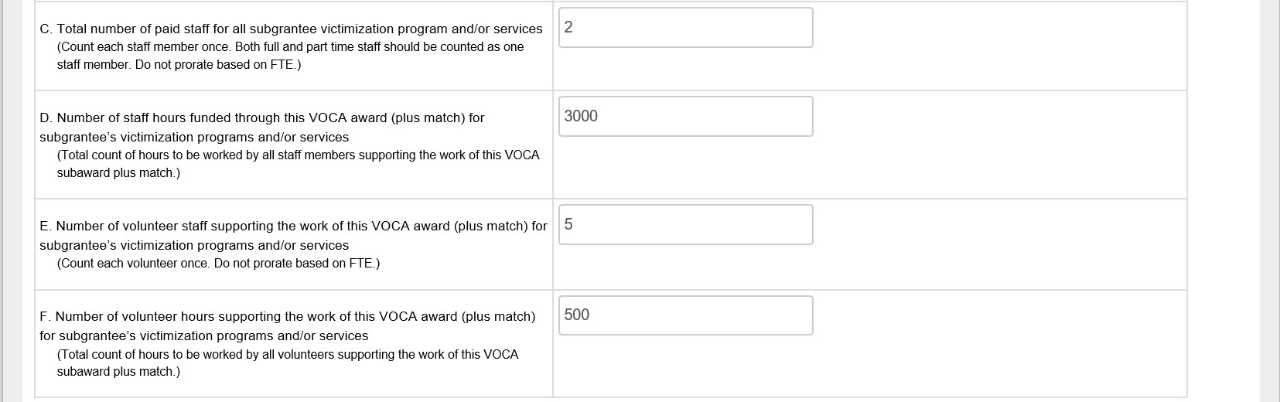
SAR–Part Two: Budget and Staffing
(cont.)
In Question 11.C–11.F, indicate the number of positions (i.e., staff members) supporting all subgrantee programs and the number of their hours funded by VOCA plus match. Also, indicate the number of volunteer staff and volunteer hours.
Please refer to the Subgrant Award Report FAQ for additional guidance on calculating number of positions and hours and how to prorate data if staff are supported by VOCA and non-VOCA funds.

Slide 30

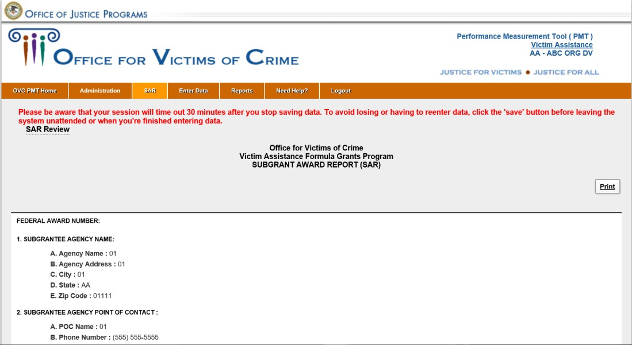
SAR Review
Once you saved your data for SAR–Part 2, you will be brought to the SAR Review page.
Within this page, you can review all SAR data entered by both the grantee and subgrantee to confirm its accuracy.

Slide 31
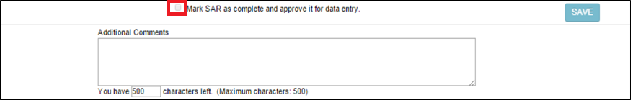
SAR Review
Once your data entry is complete, select the Save button. You will then receive a message stating that your data has been certified.
Notify your grantee will then be able to review the SAR data and click the radio button approving the SAR.
Note: The SAR must be approved by your grantee before you can complete your data entry for the performance measures for the Subgrantee Data Report.

Slide 32
Preparing the
Subgrantee Data Report

Slide 33
Subgrantee Role in Data Entry
As a subgrantee, your role in performance measurement reporting includes—
Collection:
  Collect data for all performance measures listed in the PMT
  Consider using the Subgrantee Data Tracking Template to collect and aggregate data on individual victims served.
Reporting:
  Report data on a quarterly basis
  Follow state processes and deadlines for submitting performance data.
Communication:
  Contact the SAA if there are questions about how to report data
  Look for emails from the SAA and the OVC PMT Helpdesk with reminders and
information
  Respond to inquiries from the SAA about data entered.

Slide 34
Reporting Schedule for Subgrantees
Quarterly Reporting in PMT
Reporting Period | Submission Period | Content | OVC Deadline
October 1– December 31 | January–February 15 | Performance Measures | February 15
January 1–March 31 | April 1–May 15 | Performance Measures | April 30
April 1–June 30 | July 1–August 15 | Performance Measures | July 30
July 1–September 30 | October 1–November 15 | Performance Measures and Narrative Questions | October 30
Important Note: Remember to only report on activities that occurred during the reporting period.
Important Note: Clarify any internal due dates with your SAA and any internal due dates for data entries. States build in time to review, clarify, and approve subgrantee data prior to the OVC report due date.

Slide 35

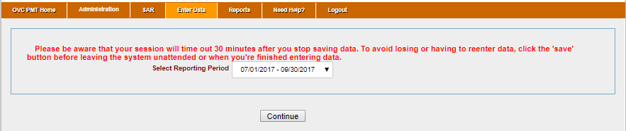
Performance Measures
Once the SAR data entry has been approved by the grantee, the subgrantee will then be able to complete their Performance Measures data entry in the Subgrantee Data Report.
Select the Enter Data tab, and a dropdown list will appear with reporting periods.
Select the reporting period for which you want to enter data.

Slide 36

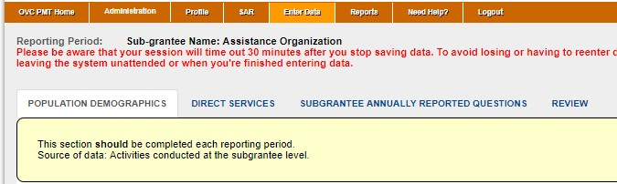
Performance Measure Screens
Users can navigate to different data entry screens by clicking on the secondary menu bar above the data entry fields.
Please refer to the Subgrantee Data Report FAQ for more detailed information
about subgrantee performance measures.

Slide 37

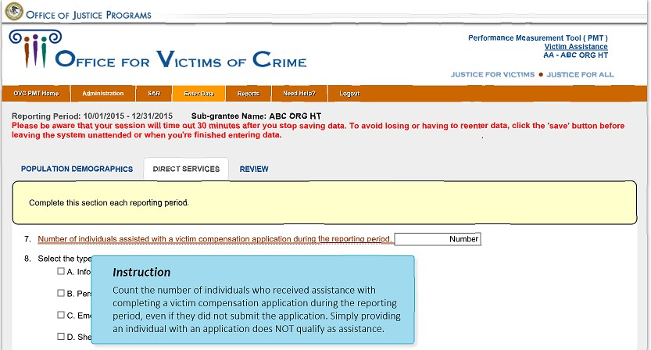
Data Entry Reminders
All fields marked “Number” will only accept numeric values.
Underlined text within the PMT is a hyperlink to a definition that will appear when you click or hover over it.
Please refer to slides 21–23, “Quick Tips for Navigating the PMT,”
for a full list of tips for using the PMT system.

Slide 38
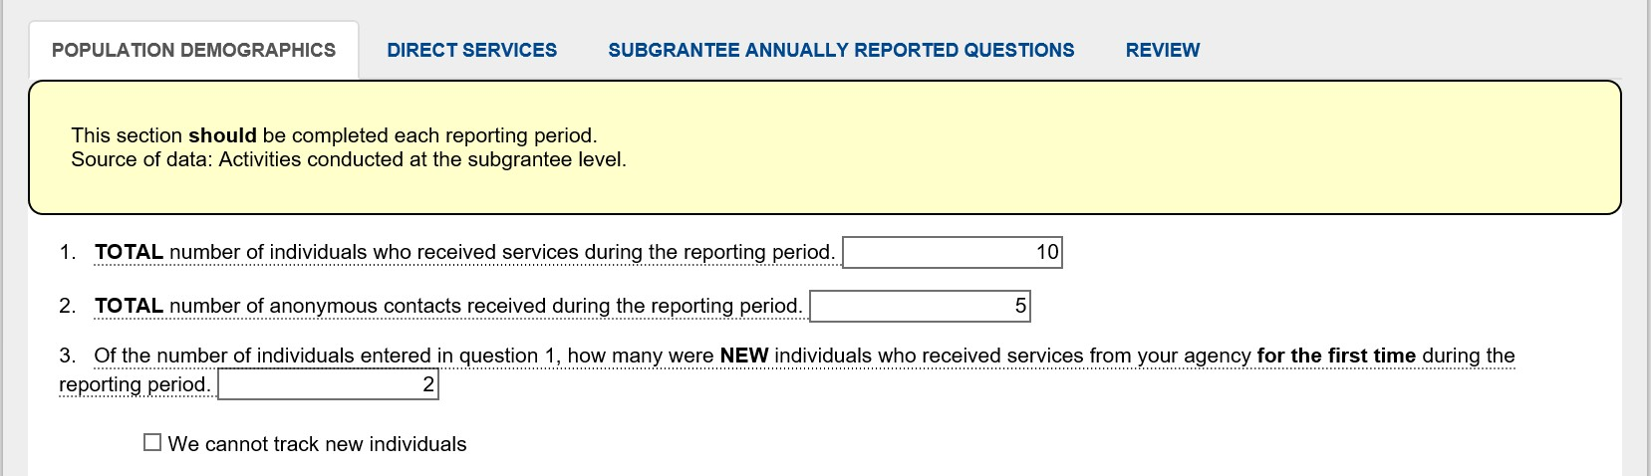
Number of Individuals Served
Enter the total number of individuals served during the reporting period and the number of anonymous contacts. See the Performance Measures: Subgrantee Data Report (June 2017) document for definitions of “individuals served” and “anonymous contacts.”
Enter the number of new individuals served for the first time during the reporting period. All individuals served will be counted as new during the first quarter of the subaward.
Check the box if you cannot track new individuals.

Slide 39
Population Demographics
Question 5: Enter demographics for only new individuals served.
  The total for each demographic category (e.g., race/ethnicity, gender identity) must equal the total of new individuals identified in question 3.
  Use the “Not Tracked” and “Not Reported” options as appropriate. See slide 22 of this user guide or the Performance Measures: Subgrantee Data Report (June 2017) for definitions of these terms.
Question 6: Enter the types of victimization presented by all individuals served and anonymous contacts. List all types of victimization presented by each individual.

Slide 40
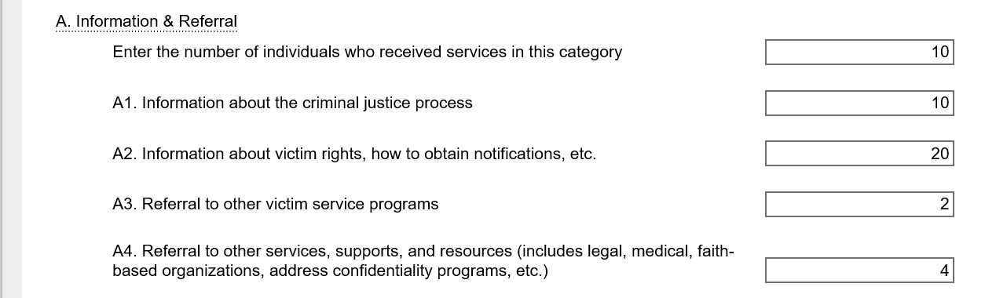
Direct Services
1
2
Report the number of individuals who receive each category of service (item 1).
Report the number of times each subcategory of service is provided (item 2).
When you add the subcategory occurrences (A1 + A2 + A3 + A4), the total should
be equal to or greater than the number of people who received services.
In this example, 10 + 20 + 2 + 4 > 10 people served.

Slide 41

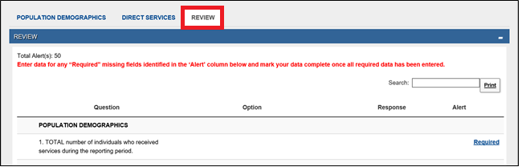
Performance Measures
After completing data entry, you will be prompted to go to the Review tab.
Subgrantees can review all data entered in the previous tabs.
Any fields missing data will be marked “Required.”
You must go back and enter data in any flagged fields before the system will allow
you to mark your data entry as complete.

Slide 42

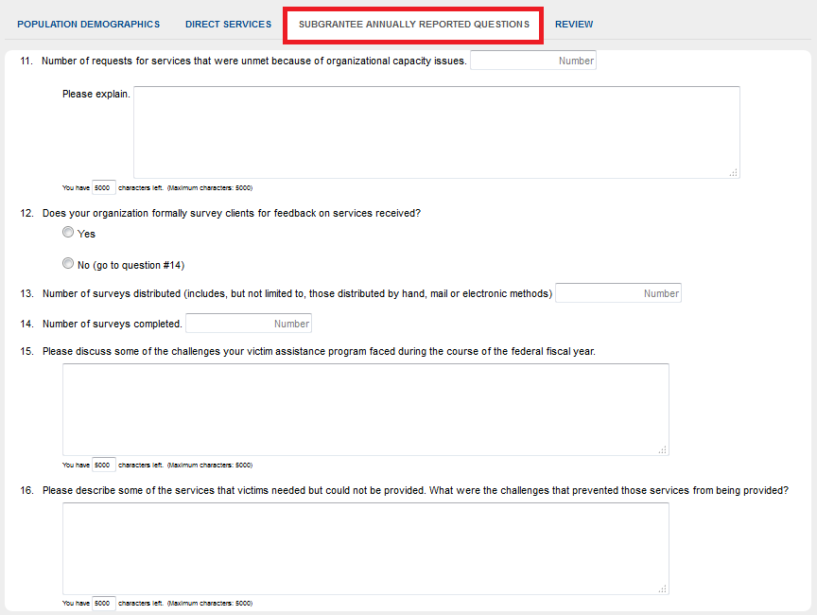
Subgrantee Annually Reported
Performance Measures
Subgrantee Annually Reported Questions
The Subgrantee Annually Reported Questions tab will appear during the July–September reporting period.
These questions only need to be answered once per year.
Enter all data, then select Save & Continue to complete your data entry.

Slide 43

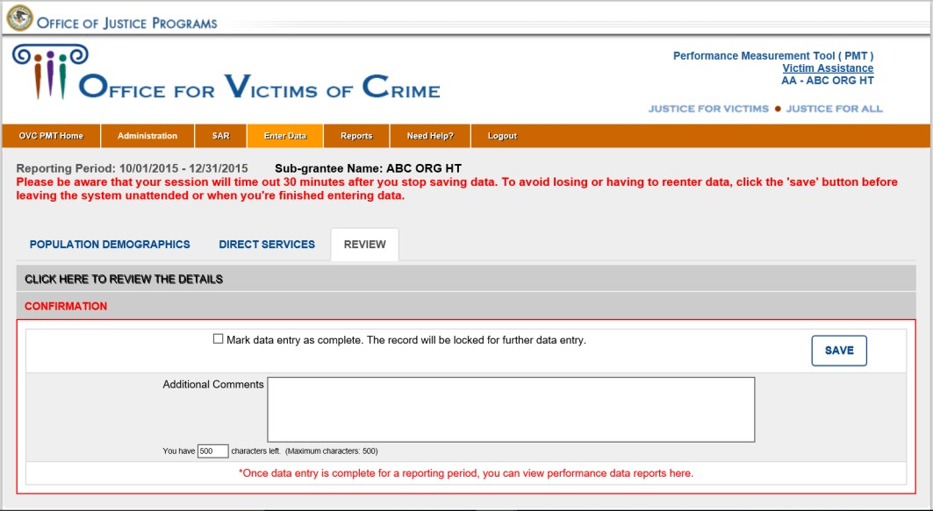
Completing Report for Grantee
Review
When you finish your data entry, you will be prompted to go to the Review tab.
Under this tab, you can review all the data you entered. If there are any missing fields, they will be marked as “Required,” and you will need to enter data in that field before continuing.
Once your data entry is complete, click the Mark data entry as complete button then select Save.
Important Note: Once subgrantees select Save, the report will be locked. If subgrantees need to unlock their report, they must contact their grantee. Grantees can unlock the subgrantee’s report by accessing the Complete and In progress tab on the Reports page of their PMT account.

Slide 44
Reports
After saving your data, the report will be automatically submitted through the
PMT to your SAA for review.
The PMT will also create a Performance Data Report in PDF format for your records.
Under the Reports tab, you can also create PDFs of your data entry in previous reporting periods.

Slide 45
OAIV Required Reports

Slide 46
Quarterly Subgrantee
Progress Report

Slide 47

OFFICE AGAINST INTERPERSONAL VIOLENCE QUARTERLY SUBGRANTEE PROJECT PROGRESS REPORT
Subgrantee Name
Subgrantee Award No
Project Director
Telephone
E-mail
Funding Source
Reporting Period
PROGRESS REPORT
In the space below, provide a report of progress towards project goals, objectives, and activities during the quarterly reporting period. This information must reflect the current sub-award agreement scope of work. Use additional pages if needed.
Goal 1:
Object 1: Activity: Activity: Object 2: Activity: Activity:
Individual(s) preparing this report must sign as indication that this report is a true and accurate reflection of funded activities during the reporting period. Any additional pages added should be initialed by the individual preparing the report and numbered.
Prepared by: Date: Page of Revised 7/23/2019 Subgrantee Quarterly Progress Report OAIV-06

Slide 48
PROGRESS REPORT (Continued)
(Copy sheet as needed)
Prepared by:
Date:
Page of
Subgrantee Quarterly Progress Report

Slide 49
PROJECT CHALLENGES/BARRIERS
Describe any challenges and/or barriers you project has faced in efforts to complete your project.
SUCCESS STORIES
Describe project success stories in this section.
Prepared by:
Date:
Page of
Subgrantee Quarterly Progress Report

Slide 50
Monthly Activity Log

Slide 51

OFFICE AGAINST INTERPERSONAL VIOLENCE MONTHLY ACTIVITY REPORT
Agency:
Staff Name: Position:
Date | Time In | Time Out | Total Daily Hours | FVPSA Hours | DV Hours | RPE Hours | PHHS Hours | VOCA Hours | STOP Hours | SASP Hours | OTHER Hours | Activity
Grand Total
Percent
Total Hours
Total Percent
Employee Signature/Date:
Supervisor Signature/Date:
Revised 7/29/2019
Monthly Activity Report
OAIV-07

Slide 52
Troubleshooting Tips
and
Additional Resources

Slide 53
General Troubleshooting Steps
If you encounter a system error—
  Log out of your PMT account and login again using the same browser
  Try to access your report from a different browser (Internet Explorer, Firefox,
or Google Chrome)
  Clear the cache and cookies on your browser
  Restart your computer
  Access the PMT during non-peak periods such as the early morning or late evening
  Ensure that JavaScript is enabled on your computer.

Slide 54

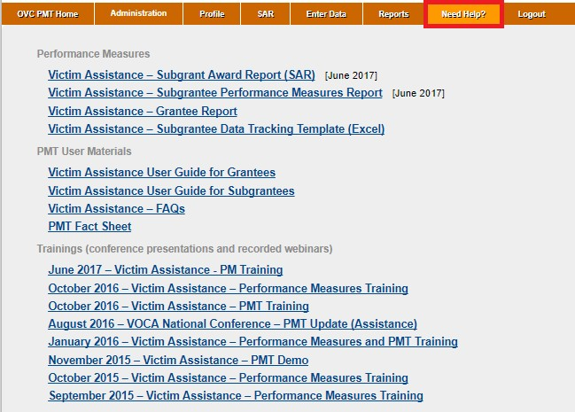
Need Help Page
Performance Measures: A list of all performance measures with explanations
Subgrantee Data Tracking Template: A tool to help subgrantees collect data
Frequently Asked Questions: Provides additional information on reporting performance measures
PMT User Guides: Includes tips for navigating through the PMT system
Training Materials: Allows you to watch recordings and view presentations about reporting performance measures

Slide 55
Additional Information
OVC PMT Helpdesk
You can contact the OVC PMT Helpdesk Monday–Friday, 8:30
a.m. to 5:30 p.m. ET via email at ovcpmt@usdoj.gov or call the toll free number: 1–844–884–2503.
State Administrative Agency
If you have questions relating to your subaward information, performance measures reporting, or state reporting deadlines, please contact your grantee or State Administrative Agency.

